Slide 1

Lecture 8: Reflection and Transmission of Waves
Instructor: Dr. Gleb V. Tcheslavski
Contact:
gleb@ee.lamar.edu
Office Hours:
Room 2030
Class web site: www.ee.lamar.edu/gleb/em/Index.htm

Slide 2
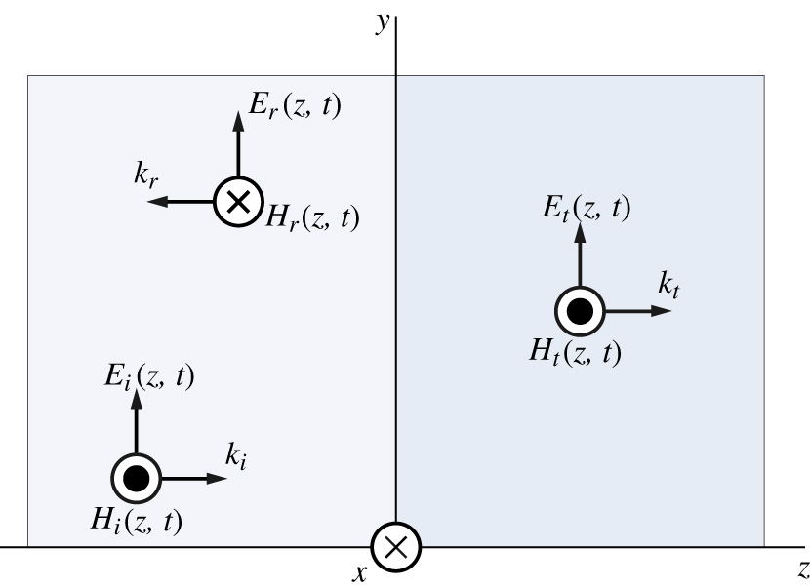
Normal incidence – propagating waves
So far, we have considered plane waves in an infinite homogeneous medium. A natural question would arise: what happens if a plane wave hits some object? Such object can be either dielectric or conductor.
To answer this question, we need to use boundary conditions. We study first normal incidence on the boundary.
We assume that a plane wave is generated in the region z < 0 in a lossless material with dielectric constant ε₁ and that a second lossless material is in the region z ≥ 0 with a dielectric constant ε₂. The permeabilities of both materials are μ₀.
A portion of the wave is transmitted to the medium 2, another portion is reflected back to medium 1.

Slide 3
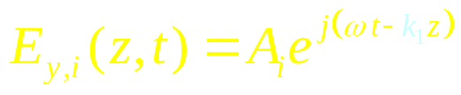
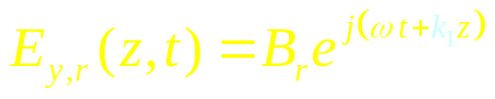
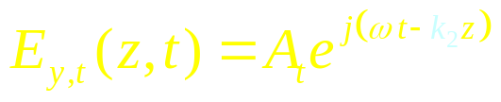
Normal incidence – propagating waves
The direction of wave’s propagation can be defined using a right hand rule. This suggests that the polarization of the reflected field has to be altered after the incident wave strikes the interface. We assume that the electric component is unchanged, and the magnetic field will change its direction.
Therefore:
Incident wave:
(8.3.1)
Reflected wave:
(8.3.2)
Transmitted wave:
(8.3.3)
Here, k₁ and k₂ are the wave numbers for the regions (media) 1 and 2 respectively, constants A and B indicate the terms propagating in the +z and –z directions.
Since the materials are assumed as lossless, the waves will not attenuate (i.e. α = 0, β = k). The magnetic field intensities can be found from the Maxwell’s equations or by using the characteristic impedances for two regions.

Slide 4
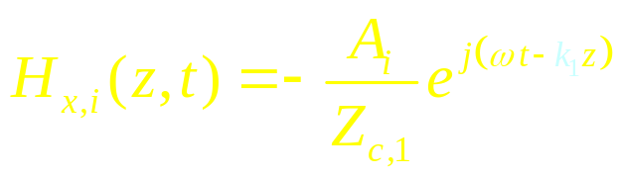
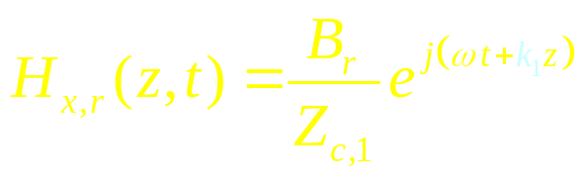
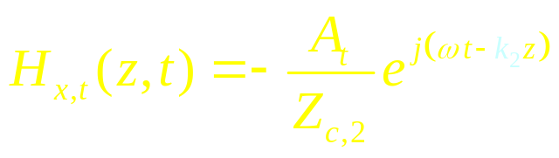
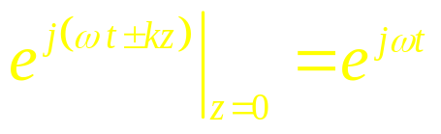
Normal incidence – propagating waves
Incident wave:
(8.4.1)
Reflected wave:
(8.4.2)
Transmitted wave:
(8.4.3)
From the boundary conditions, the tangential components of the electric field must be continuous and the tangential components of the magnetic field intensity must differ by any surface current that is located at the interface. Usually, we assume that there are no surface currents, which implies that the tangential components of the magnetic field intensity are also continuous at the interface.
Also, since we chose the interface between two media to be at z = 0, the exponent will be
(8.4.4)

Slide 5
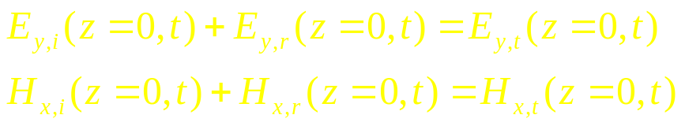
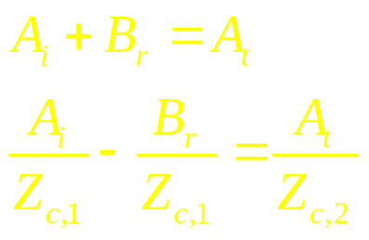
Normal incidence – propagating waves
Therefore, at the boundary z = 0, we can write:
(8.5.1)
(8.5.2)
Substituting the last results to (8.3.x) and (8.4.x), we obtain:
(8.5.3)
(8.5.4)
Therefore, if one of three wave’s magnitudes is known, two other can be computed.

Slide 6
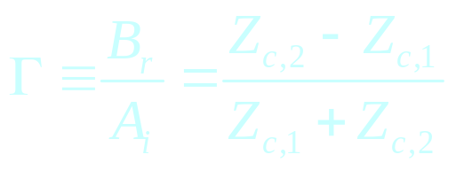
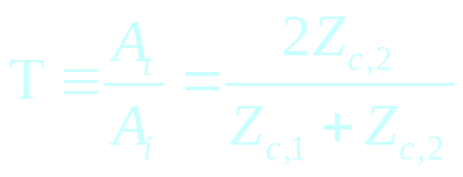
Normal incidence – propagating waves
We specify the reflection and transmission coefficients as:
Reflection:
(8.6.1)
Transmission:
(8.6.2)
Knowing the characteristic impedances of the materials allows us to determine the propagation characteristics and amplitudes of both waves: transmitted to the second medium and reflected back. If the characteristic impedances on both sides are equal, all energy is transmitted into region 2 and none is reflected back. This is called matching the media (lenses, glasses etc.).

Slide 7

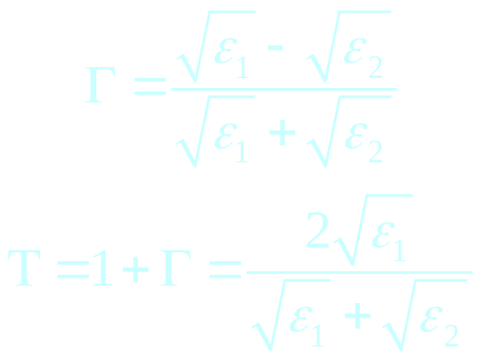
Normal incidence – propagating waves
Since the characteristic impedance is:
(8.7.1)
For two dielectric materials:
Reflection:
(8.7.2)
Transmission:
(8.7.3)

Slide 8
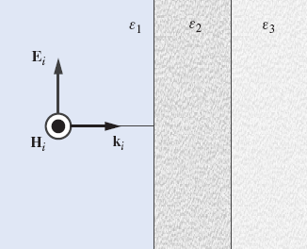
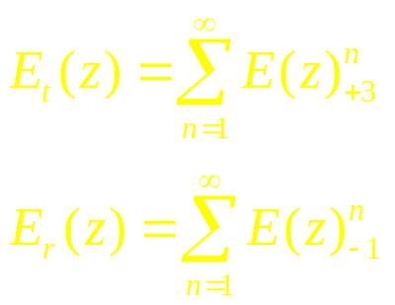
Normal incidence – propagating waves (Example)
Example 7.1: Describe the expected reflection-transmission characteristic of a time harmonic EM wave normally incident at a layered dielectric. Find the total reflection and transmission coefficients of a single layer with known thickness d and dielectric constants are ε₂ = ε_{r}ε₀; ε₁ = ε₃ = ε₀. Plot the frequency dependence of these coefficients assuming d = 0.1 m and ε_{r} = 4.
z
The amplitudes of the total transmitted and reflected fields are
(8.8.1)
wave index
(8.8.2)
-z direction
region number

Slide 9
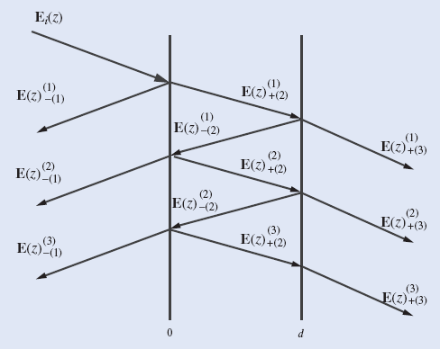





Normal incidence – propagating waves (Example)
The wave incident to the boundary with the second medium is partially reflected back and partially transmitted to medium 2. At the interface between materials 2 and 3, the transmitted to material 2 field is partially reflected back and partially transmitted to the material 3, etc.
The phase of individual terms in summations is different: an additional phase difference of k₂d appears after each crossing the slab.
We assume next that the reflection coefficient from the first interface is Γ₁ in the +z direction and -Γ₁ in the –z direction. Since the medium 3 is identical to medium 1, Γ₂ = -Γ₁, and -Γ₂ = Γ₁. Similarly, the transmission coefficient through the first interface will be Τ₁⁺ = 1 + Γ₁ in the +z direction and Τ₁⁻ = 1 - Γ₁ in the -z direction.

Slide 10
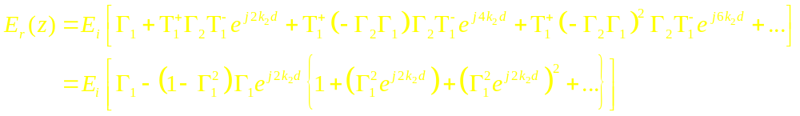
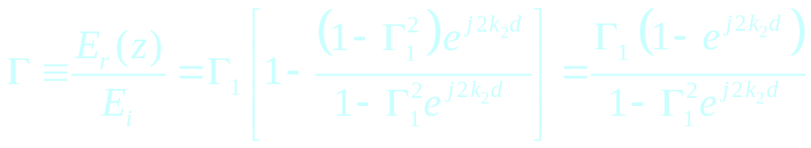
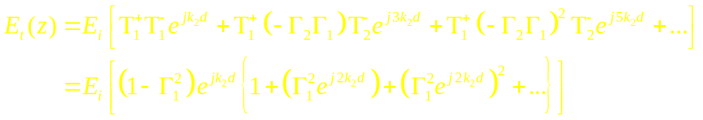
Normal incidence – propagating waves (Example)
The total reflected electric field is:
(8.10.1)
The total reflection coefficient is:
(8.10.2)
Similarly, the total transmitted electric field is:
(8.10.1)

Slide 11
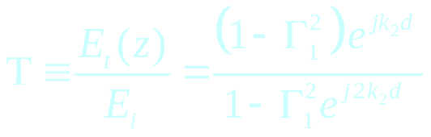
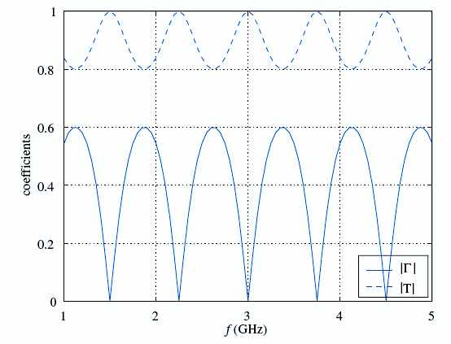
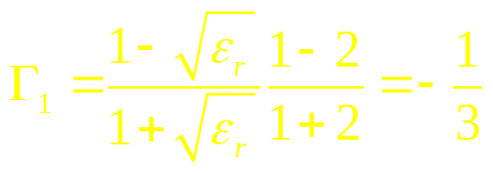
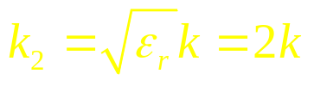
Normal incidence – propagating waves (Example)
The total transmission coefficient is:
(8.11.1)
The reflection coefficient of the first boundary is:
(8.11.2)
The wave number in the slab:
(8.11.3)
The frequency dependence of the total transmission and reflection coeffs:

Slide 12


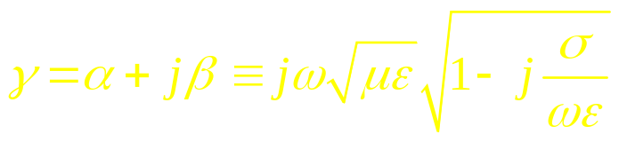
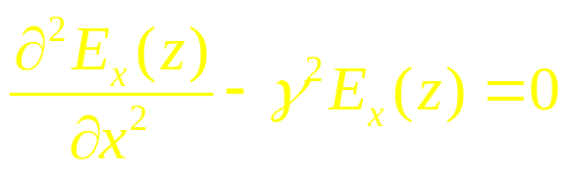
Normal incidence – propagating waves
What if the medium where the wave is propagating is lossy, i.e. σ ≠ 0?
The magnetic field must be:
(8.12.1)
The Helmholtz equation is:
(8.12.2)
where the complex propagation constant is:
(8.12.3)
If the electric field is linearly polarized in the x direction, wave equation reduces to:
(8.12.4)

Slide 13

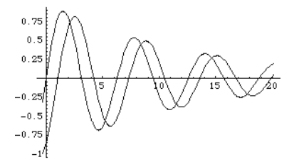
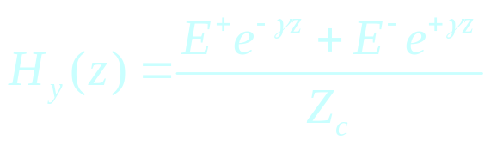

Normal incidence – propagating waves
The solution will be in form:
(8.13.1)
Traveling exponentially decaying waves
The first term – a wave propagating in +z direction:
(8.13.2)
The magnetic field will be:
(8.13.3)
Alternatively, loss can be incorporated by:
(8.13.4)

Slide 14
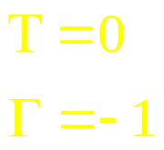
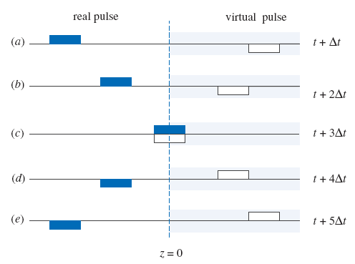
Normal incidence – propagating waves
If the material 2 is a good conductor, the characteristic impedance will be very small and it would approach zero as the conductivity approaches infinity. Therefore, it will be NO transmission of EM energy into the conductor, it all will be reflected. In this case:
(8.14.1)
Polarization change
(8.14.2)
Considering the most general solution (7.12.3) of the wave equation and a traveling pulse instead of a time-harmonic wave, we may assume that a virtual pulse with a negative amplitude was launched at z = +∞ in the –z direction simultaneously with the real pulse. Both pulses meet at z = 0 at the time t = t + 3Δt after that moment, they keep propagating but the virtual pulse becomes real and the real one becomes virtual.

Slide 15
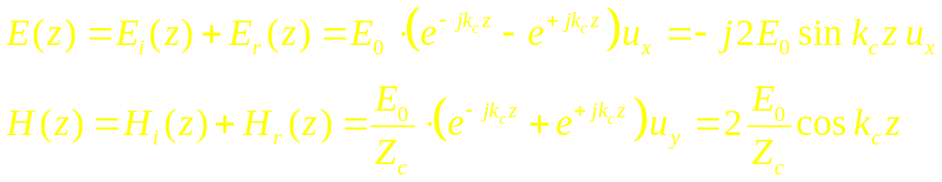
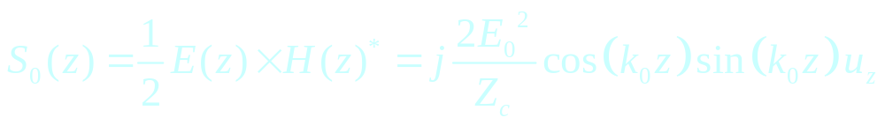
Normal incidence – propagating waves
At the interface, the amplitudes of both pulses add up to equal zero in order to satisfy the requirement that the tangential component of the electric field must be zero at a perfect conductor.
Fields exist only in the region z < 0 (medium 1 – dielectric):
(8.15.1)
(8.15.2)
Note that at z =0: E(z) = 0 and H(z) = 2E₀/Z_{c} u_{y}.
The Poynting vector for the first region (z < 0) will be:
(8.15.3)

Slide 16
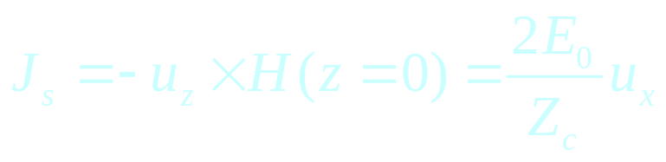
Normal incidence – propagating waves
Since the Poynting’s vector has no real part, NO average power is delivered to the region 2 (perfect conductor)!
The surface current on the conductor can be found from the boundary conditions on the tangential magnetic field:
(8.16.1)
This is where “no metal plates in a microwave oven” comes from!

Slide 17
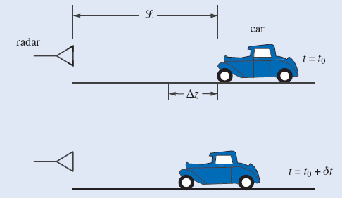
Normal incidence – propagating waves (Example)
Example 7.2: Pulse radars can be used to determine the velocity of cars. Show how such radars could work.
A repetitive EM pulse from the radar is incident on the car. Because of the high conductivity of the car, the pulse is reflected back to the radar where the total time of travel Δt for the given pulse can be estimated. The pulse repetition time (the time between two consecutive pulses) is δt.

Slide 18
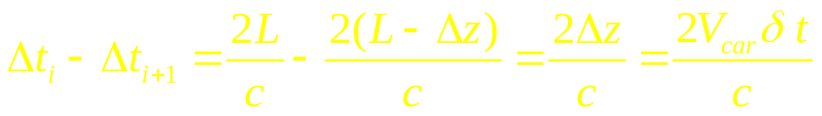
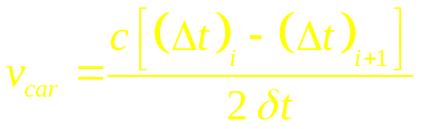
Normal incidence – propagating waves (Example)
During δt, the car travels a distance Δz; therefore, the velocity of the car can be estimated.
The difference in arrival time for two pulses
(8.18.1)
The velocity is:
(8.18.2)
The actual distance between the car and the radar L is not important to determine the car’s speed; although it can be computed as well.

Slide 19
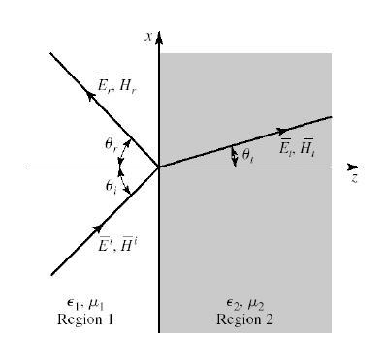
Oblique incidence – propagating waves
When a plane EM wave incident at an oblique angle on a dielectric interface, there are two cases to be considered: incident electric field has polarization parallel to the plane of incidence, and incident electric field has polarization that is perpendicular to the plane of incidence.
1. Parallel polarization:
The incident, reflected, and transmitted electric field vectors lie in the plane of incidence: the x-z plane.
Note: the angles are measured with respect to normal.

Slide 20
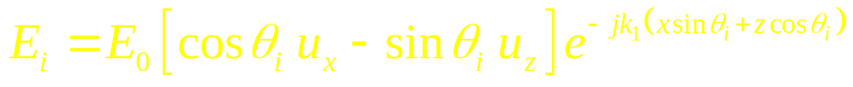
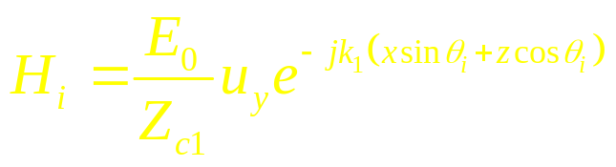
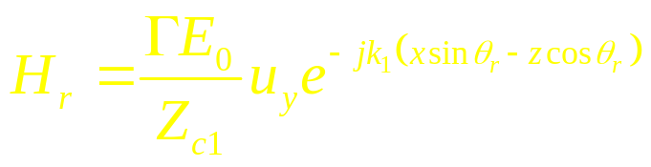
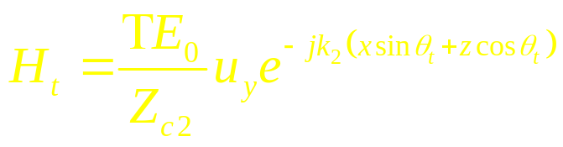
Oblique incidence – propagating waves
Incident wave:
(8.20.1)
(8.20.2)
Reflected wave:
(8.20.3)
(8.20.4)
Transmitted wave:
(8.20.5)
(8.20.6)

Slide 21
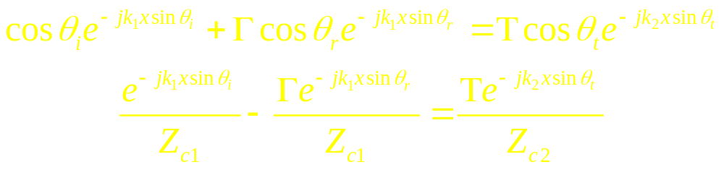

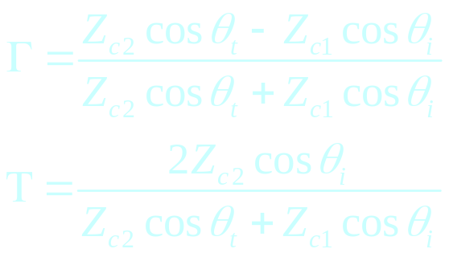
Oblique incidence – propagating waves
From the boundary conditions: i.e., continuity of tangential electric and magnetic fields at the interface z = 0, we derive:
(8.21.1)
(8.21.2)
To satisfy these conditions, the Snell’s laws of reflection and refraction must hold:
(8.21.3)
These simplifications lead to:
(8.21.4)
(8.21.5)

Slide 22

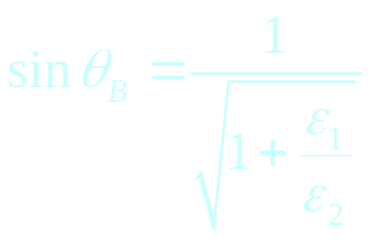
Oblique incidence – propagating waves
For parallel polarization, a special angle of incidence exists, known as the Brewster’s angle, or polarizing angle, θ_{i} = θ_{B}, for which the reflection coefficient is zero: Γ = 0.
It happens when
(8.22.1)
Therefore:
(8.22.2)
If the incidence angle equals to Brewster’s angle, the reflected field will be polarized perpendicularly to the plane of incidence.

Slide 23
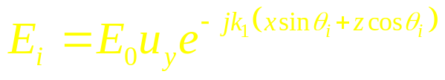
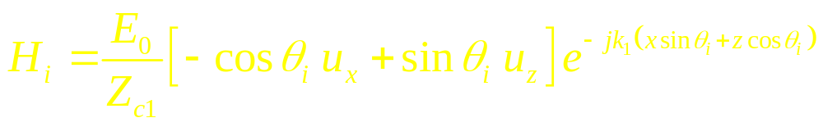
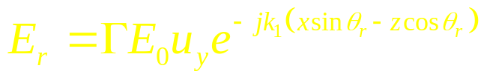
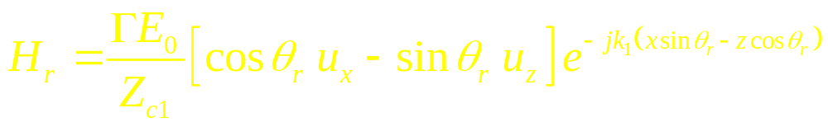
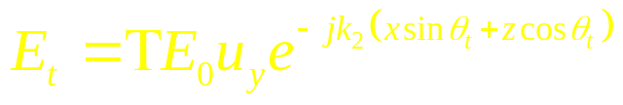
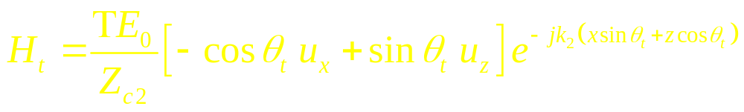
Oblique incidence – propagating waves
1. Perpendicular polarization:
The incident, reflected, and transmitted electric field vectors are perpendicular to the plane of incidence: the x-z plane.
Incident wave:
(8.23.1)
(8.23.2)
Reflected wave:
(8.23.3)
(8.23.4)
Transmitted wave:
(8.23.5)
(8.23.6)

Slide 24
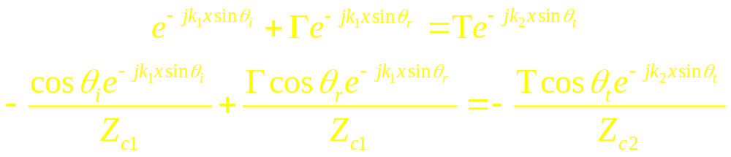

Oblique incidence – propagating waves
From the continuity of tangential electric and magnetic fields at the interface z = 0, we again derive:
(8.24.1)
(8.24.2)
As before, the Snell’s laws of reflection and refraction must hold:
(8.24.3)
These simplifications lead to very similar expressions:
(8.24.4)
(8.24.5)

Slide 25

Oblique incidence – propagating waves
A magnitude of the reflection coefficient for the parallel and perpendicular polarization:

Slide 26


Oblique incidence – propagating waves
Total internal reflection and surface waves
Assume that the uniform plane wave incident on an interface between two perfect dielectrics with k₁ > k₂, for instance, water to air. From the Snell’s law:
(8.26.1)
For a particular angle of incidence, the quantity under the square root becomes zero. This angle is called critical angle:
(8.26.2)
At the incidence angles exceeding the critical angle, the phenomenon of total internal reflection occurs.

Slide 27



Oblique incidence – propagating waves
Let us denote:
(8.27.1)
In both cases of parallel and perpendicular polarization, the reflection coefficient will be:
(8.27.2)
Here, both α and β are real. As a consequence, the magnitude of the reflection coefficient |Γ| = 1, and all incident power is reflected off the interface.
As a result, for instance for the perpendicular polarization, the transmitted electric field is:
(8.27.3)
If the incidence angle exceeds the critical angle, the field in region 2 propagates in the x direction but rapidly exponentially decays in the z direction – away from the interface. This is a surface wave.

Slide 28


Fabry-Perot resonator – standing waves
Let us consider again the electric component of a linearly polarized EM field normally incident on a perfect conductor with a reflection coefficient Γ = -1.
(8.28.1)
(8.28.2)
Where A = 2B.
The tangential electric field E_{y}(z,t) = 0 at the interface z = 0. In this case, the signal consisting of two oppositely propagating waves appears to be stationary in space and oscillating in time. This is a standing wave.

Slide 29

Fabry-Perot resonator – standing waves
The standing wave results from the constructive and destructive interference of the two counter propagating waves.
Observe that the separation distance between two successive null points (nodes) equals to the separation distance between two successive maxima (antinodes) and equals to one half of the wavelength.

Slide 30



Fabry-Perot resonator – standing waves (Example)
Example 7.3: An EM wave propagating in a vacuum in the region z < 0 is normally incident upon a perfect conductor at z = 0. The frequency of the wave is 3 GHz, the amplitude of incident electric field is 10 V/m, and it is polarized in the u_{y} direction. Find the phasor and the instantaneous expressions for the incident and the reflected field components.
(8.30.1)
The incident field in the phasor form:
(8.30.2)
(8.30.3)
Or:
(8.30.4)
(8.30.5)

Slide 31


Fabry-Perot resonator – standing waves (Example)
The reflected field in the phasor form:
(8.31.1)
(8.31.2)
Or in the instantaneous form:
(8.31.3)
(8.31.4)
Constructive and destructive interference will lead to appearance of a standing wave.

Slide 32

Fabry-Perot resonator – standing waves
Examination of a standing wave suggests that it should be possible to insert another conductor (a conductive wall) at any of the nodes where the tangential electric field is zero without changing a structure of electric field!
The applicable boundary condition, therefore, is that the tangential electric field must be zero at a conductive surface.
Let us assume that the plates were inserted instantaneously and the EM energy was “trapped” between the plates.

Slide 33




Fabry-Perot resonator – standing waves
For the 1D Helmholtz equation
(8.33.1)
and a time-harmonic signal, the solution will be in a form:
(8.33.2)
The integration constants A and B can be found from the boundary condition that the tangential electric field must be zero at a metal wall. Therefore, B = 0,
(8.33.3)
where n is an integer (resonator mode) and L is the distance between the metal walls. If the maximum magnitude of electric field is E_{y0}, the electric field is
(8.33.4)

Slide 34

Fabry-Perot resonator – standing waves
The structure consisting of a parallel plate cavity is called a Fabry-Perot resonator. If the frequency of a wave “matches” the dimensions of the resonator (a resonant frequency) – the length of cavity equals an integer number of half-wavelengths – a standing wave will be formed. All other frequency components will be canceled out by a destructive interference.
The Q-factor (2π ratio of stored energy to the power dissipated per cycle) of this resonator may be very high (approaches a million).
Fabry-Perot resonators are widely used in EM and optics: a He-Ne laser is basically a Fabry-Perot resonator.

Slide 35




Fabry-Perot resonator – standing waves
Recall that the wave number is a function of frequency and the velocity of light between plates.
Therefore, we can find the resonant frequency as
(8.35.1)
(8.35.2)
Considering two resonators of the same length L but one of the filled with air (left) and the other filled with a dielectric ε, we can find that they will resonate at two different frequencies. The frequency difference will be
(8.35.3)

Slide 36



Fabry-Perot resonator – standing waves
The resonant frequency for a free space (or air) can be computed or measured for known resonator’s dimensions. The relative frequency difference is
(8.36.1)
Therefore, if we can measure this frequency difference, we can estimate the permittivity of unknown material placed in the resonator and, thus, identify the material.
Example 7.4: An empty Fabry-Perot resonator has a resonant frequency of 35 GHz. Determine the thickness of a sheet of paper that is inserted later between the plates if the resonant frequency changes to 34.99 GHz. The separation between plates is 50 cm. Assume that the integer n specifying the mode doesn’t change and that there is no reflection from the paper.

Slide 37




Fabry-Perot resonator – standing waves (Example)
The relative dielectric constant separating the plates with paper inserted can be approximated as
(8.37.1)
(8.37.2)
Therefore:
(8.37.3)
Finally:

Slide 38



Fabry-Perot resonator – standing waves (Example)
Example 7.5: A helium-neon laser emits light at a wavelength of 6328 Å in air. Calculate the frequency of oscillation of the laser, the period of oscillation, and the wave number. 1 Å (Åmgstrom) = 10⁻¹⁰ m.
The frequency:
The period:
The wave number:
??QUESTIONS??

